Slide 1
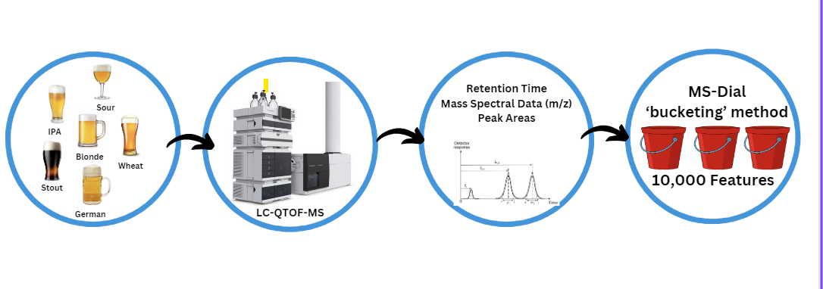
How Dataset Was Obtained

Slide 2
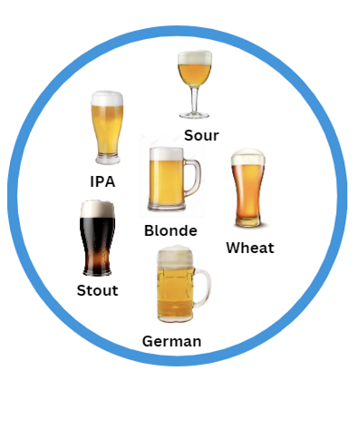
Beer Samples
Beer samples sent from Germany
Most common types of beers
Beer is composed of a wide variety of chemical compounds, including sugars, proteins, phenolic compounds, hops-derived substances, yeast metabolites, etc..
Due to the sheer number of unknown compounds in beer, multivariate analysis and machine learning techniques are needed to pinpoint the compounds that are most influential in distinguishing beer styles

Slide 3
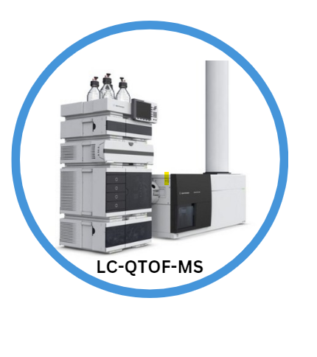
Liquid Chromatography Quadrupole Time-of-Flight Mass Spectrometer
Liquid Chromatography (LC): Liquid chromatography is used to separate the components of a sample (such as beer) into individual compounds
Quadrupole Mass Analyzer: allows only specific mass-to-charge ratio (m/z) ions to pass through, filtering out unwanted ions.
Time-of-Flight Mass Analyzer (TOF-MS): ions are accelerated and travel through a flight tube. The time it takes for ions to reach the detector provides information about their mass-to-charge ratio. This data is crucial for identifying the molecules present in the sample.

Slide 4
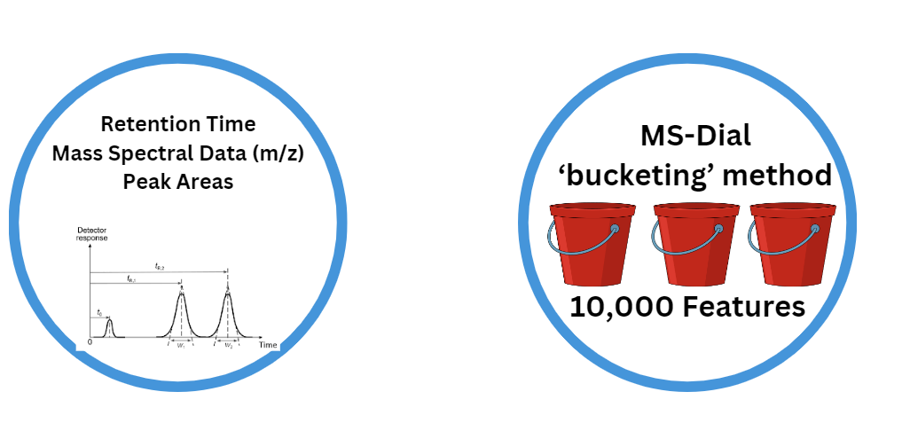
Data Acquisition
Retention Time: time it takes for a compound to travel through the chromatographic column and elute from the column.
Ion Mass Spectral Data (m/z): mass of an ionized molecule divided by its charge.
Peak Areas: intensity of the signals detected at specific retention times and m/z values.
Notes:
Retention Time: time it takes for a compound to travel through the chromatographic column and elute from the column.
Ion Mass Spectral Data (m/z): mass of an ionized molecule divided by its charge. Mass spectrometry measures the mass-to-charge ratio of ions to identify and quantify compounds.
Peak Areas: intensity of the signals detected at specific retention times and m/z values. These areas correspond to the abundance or concentration of specific compounds in the samples.

Slide 5
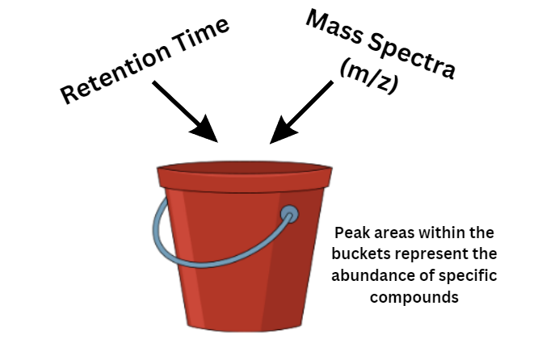
Data Processing
The bucketing method, also known as binning or discretization, is a technique used in data analysis to group continuous data into discrete intervals or "buckets.
Each ‘bucket’ represents a feature
Peak areas within the buckets represent the prevalence or abundance of specific ions or compounds within those intervals
10,000 such features, each representing a specific combination of retention time and m/z range, along with the corresponding peak area

Slide 6
Beer Dataset
72 beer samples from 7 categories of beer (blonde, german, IPA, Stout, Wheat, Sour) ran using LC-QTOF-MS
10,000 features obtained
LC-QTOF-MS data provides intensity and retention time
Intensity refers to the abundance or concentration of ions detected at a specific mass-to-charge ratio (m/z) in the mass spectrometer.
Retention time is the time it takes for a compound to travel through the chromatographic column during liquid chromatography.
3D (mass to charge ratio, retention time, intensity) -> features extracted

Slide 7
Samples/QC (Beer List)
Brewer | Brand | Category | Label | QC | QC
Deep Elum | Dallas Blonde | Blonde | BLD1 | BLD_QC | ALL_QC
Karbach | Love Street | Blonde | BLD2
Kurzer | Altbeir (Beer#2) | German | GER2 | GER_QC
Hausbrauerei "Zum Schlussel" | Altbeir (Beer#4) | German | GER4
Uerige Obergarige | Altbeir (Beer#1) | German | GER1
Schlussel Gmbh | Altbeir (Beer#5) | German | GER5
Fuchschen | Altbeir (Beer#3) | German | GER3
Schumacher | Altbeir (Beer#6) | German | GER6
Ballast Point | Sculpin | IPA | IPA1 | IPA_QC
Community | Mosaic | IPA | IPA2
Left Hand | Nitro | Stout | STU1 | STU_QC
New Holland | Dragon's Milk White | Stout | STU2
Avery | Island Rascal | Wheat | WHE1 | WHE_QC
Sierra Nevada | Sunny Little Thing | Wheat | WHE2
Tupps Brewery | Neon Shade | Sour | SOU1 | SOU_QC
Sierra Nevada | Wild Little Thing | Sour | SOU2

Slide 8
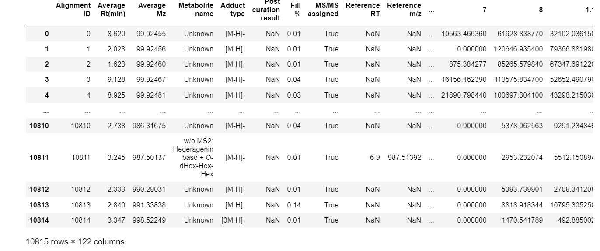
For cleaning the dataset, there is a lot of unnecessary information in the dataset, 50 columns were removed, only focusing on the features

